Slide 1
Contracts and monitoring for Vision-based Auto Landing
Febuary 2023

Slide 2
Problem Statement
Find Perception Contracts that are sufficient for assuring safety of vision-based auto-landing system
Use Perception Contract for runtime monitoring
Progress in the past week
Implementation of scene and simulation setup in Gazebo
Basic pose estimation setup (currently with large error)
Next: Planning and landing control

Slide 3
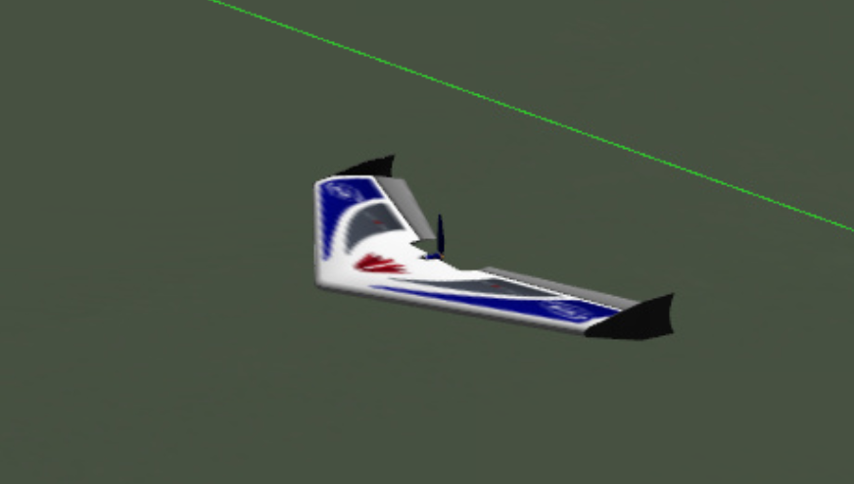
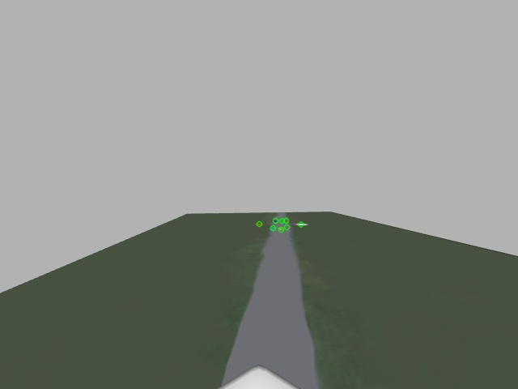
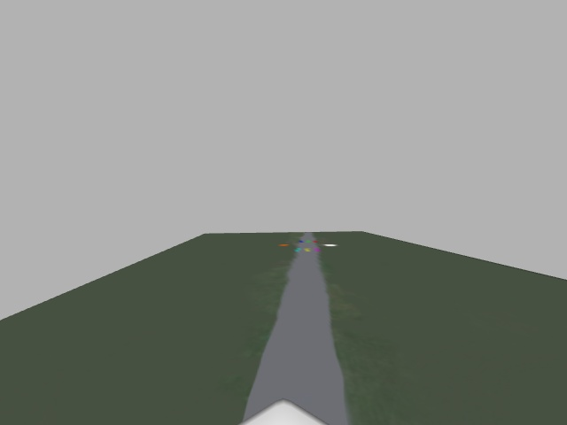
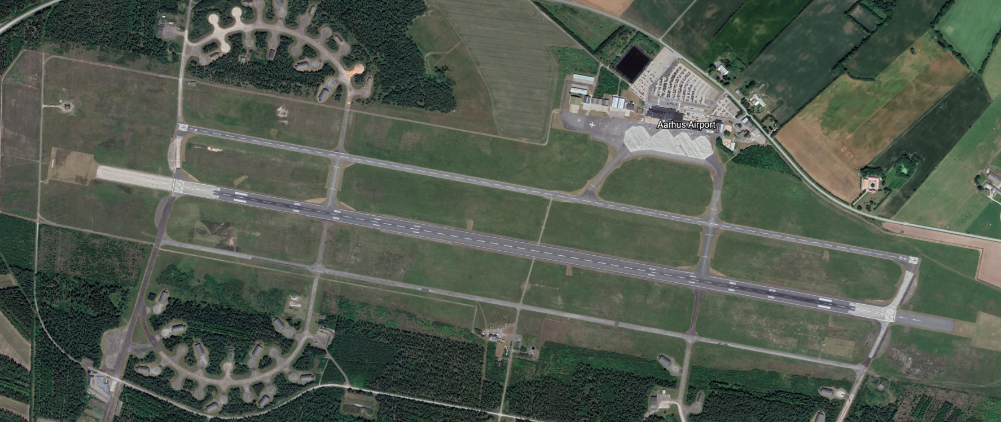
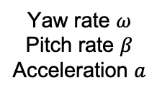
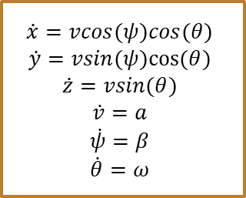
System Architecture
$$\dot{x}=vcos(ψ)cos(θ)$$
$$\dot{y}=vsin(ψ)cos⁡(θ)$$
$$\dot{z}=vsin(θ)$$
$$\dot{v}=a$$
$$\dot{ψ}=β$$
$$\dot{θ}=ω$$
Yaw rate $ω$
Pitch rate $β$
Acceleration $a$
Reference Trajectory
Generate ILS Trajectory
Controller
Aircraft Dynamics
Relative
Position
Rotation
Aircraft State
Keypoint Pixels
Pose Estimator
Keypoint Detector
Image
Gazebo Simulator
(camera)
y
Aircraft Direction
x

Slide 4
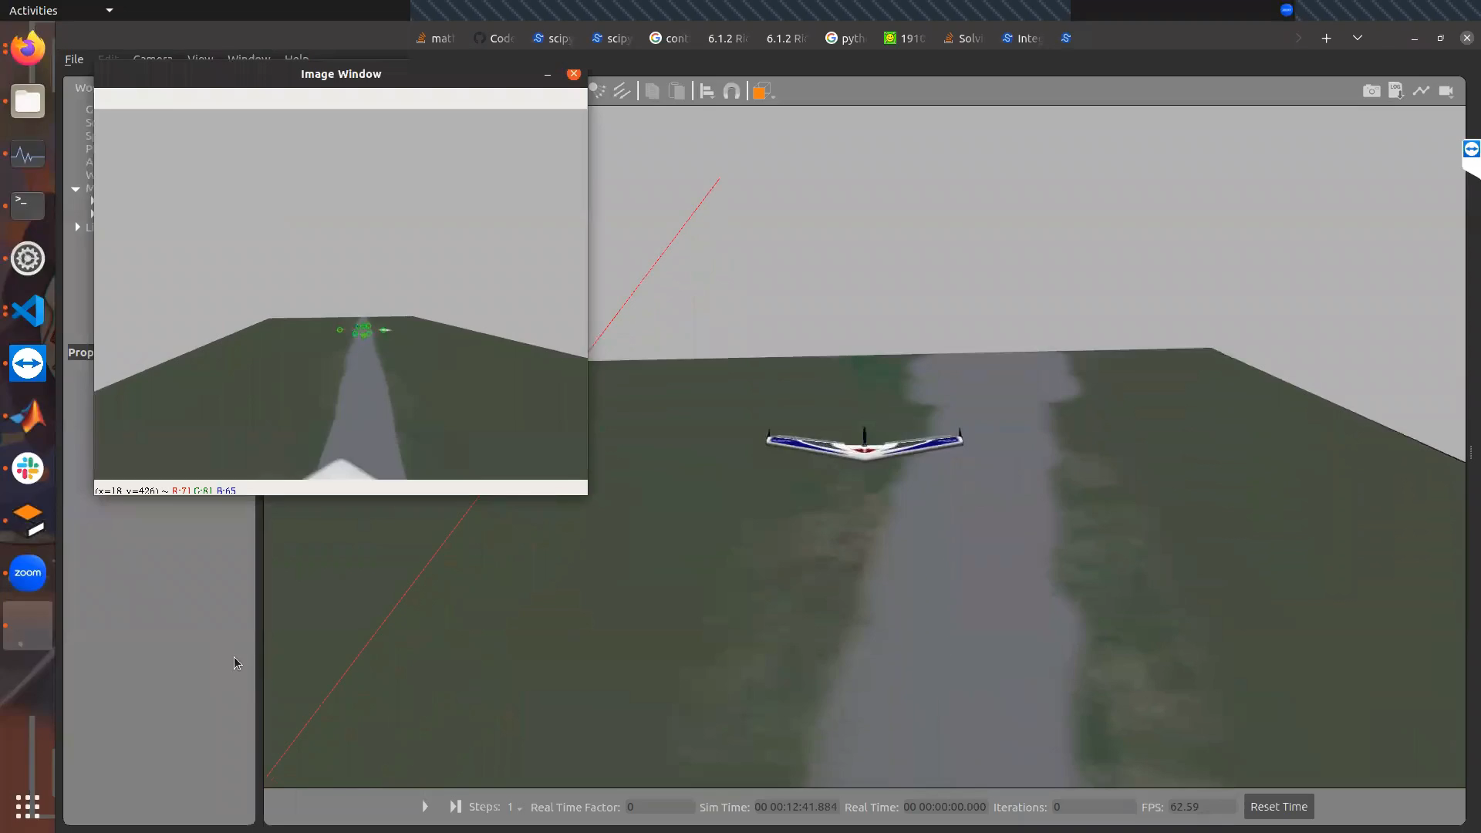
Setting Up Closed Loop Simulation
Fixed wing aircraft with Dubin’s aircraft dynamics
Simulating aircraft with camera flying over runway in gazebo
Keypoint detection based on marker color and ground truth information about keypoint locations
Planning to explore using U-Net [Ronneberger 2015] for keypoint detection
Pose estimation using Perspective-N-Point (PNP) algorithm from OpenCV

Slide 5
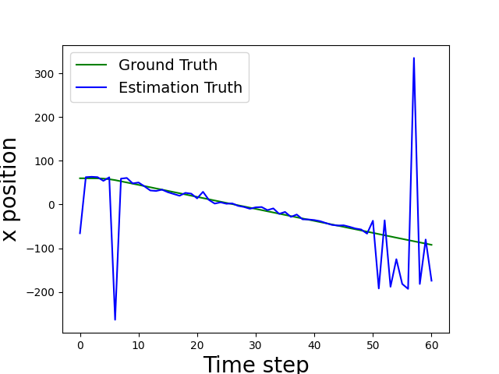
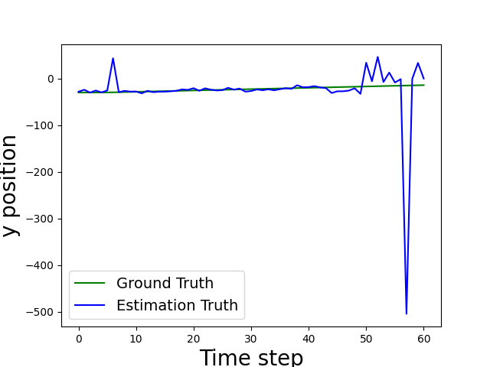
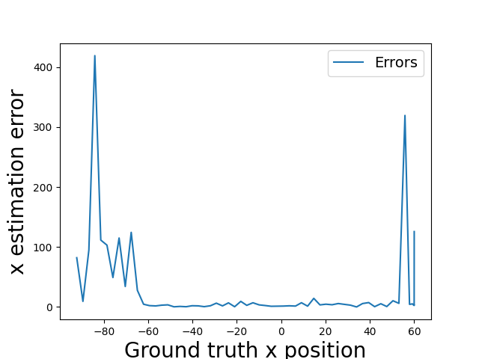
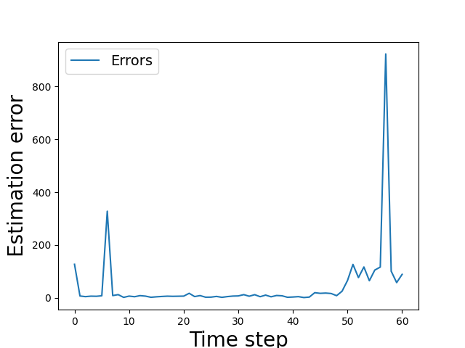
Accuracy of Pose Estimation
The estimated position of aircraft is relatively accurate
The estimated position of aircraft fluctuates as the pose of aircraft change
The estimated orientation of aircraft is not accurate

Slide 6
Discussion
We are working on improving the pose estimation errors
How to perform runtime monitoring without ground truth?
Next Step
Closed the loop for the simulation

Slide 7
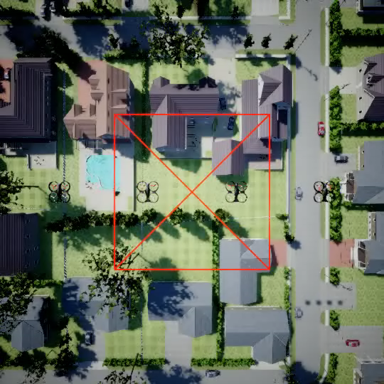
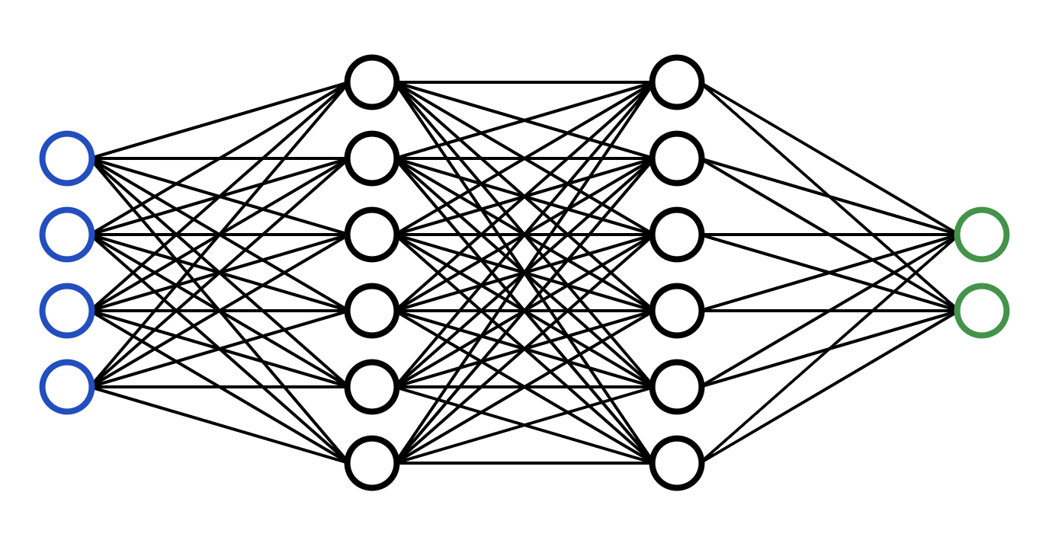
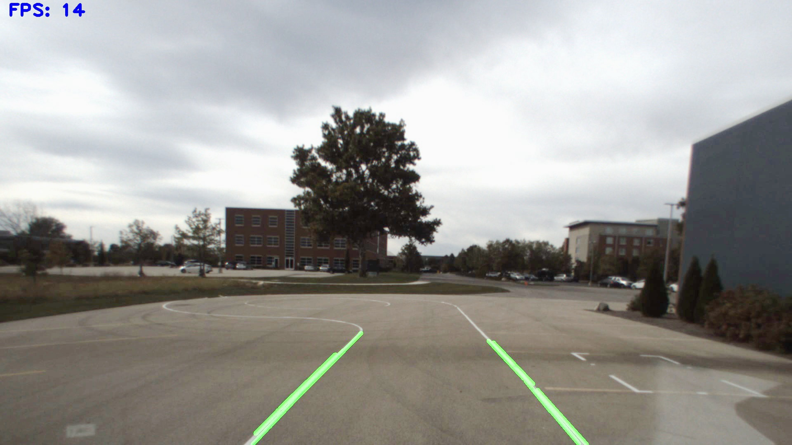
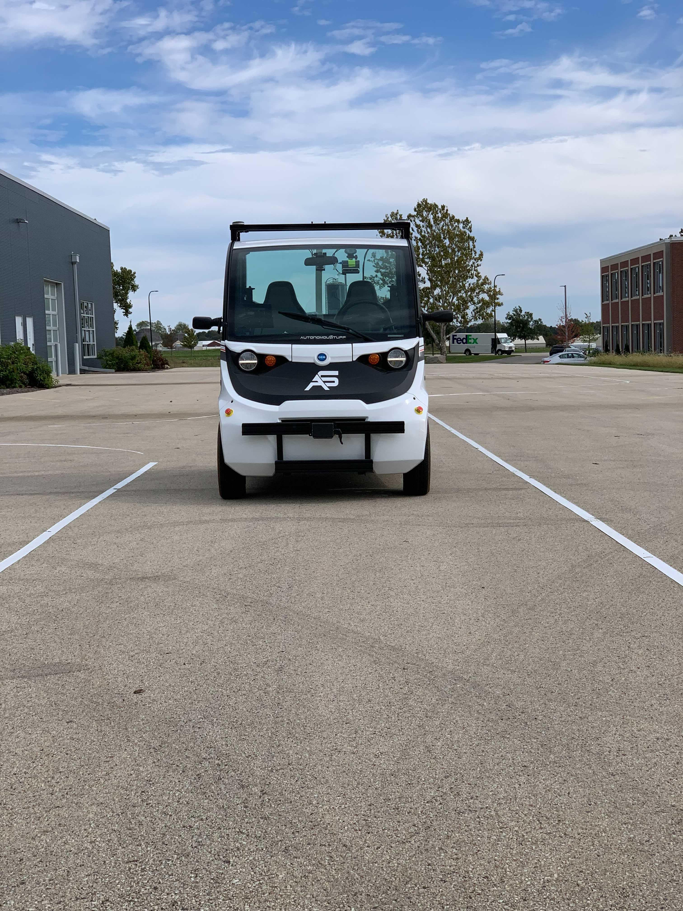
How to assure safety of DNN-driven autonomous system?
DNN
Controller
Camera
Car
We propose a notion of contracts to assure safety of vision-based lane keeping and similar systems which are becoming standard

Slide 8
Summary
A method for system-level safety certification based on Perception Contracts
A method for constructing particular types of piece-wise linear and decision trees for perception contracts
Applications to lane keeping and drone formation flight
Publications
Verifying Controllers with Vision-based Perception Using Safe Approximate Abstractions. Hsieh, Li, Sun, Joshi, Misailovic, and Mitra. In Conference on Embedded Software (EMSOFT) 2022 and Special Issue of TCAD, Shanghai, 2022.
Challenges in Rebooting Autonomy with Deep Learned Perception. Abraham, Mayne, Perez, Hsieh, Li, Oliveira, Yu, Sun, Mitra. Industry track paper Embedded Software (EMSOFT) 2022, Shanghai, 2022.
Assuring safety of vision-based swarm formation control. Hsieh, Li, Koh, and Mitra, under review 2023.
Perception Contracts for Safety of ML-Enabled Systems. Astorga, Hsieh, Madhusudan, Mitra, under review 2023.

Slide 9
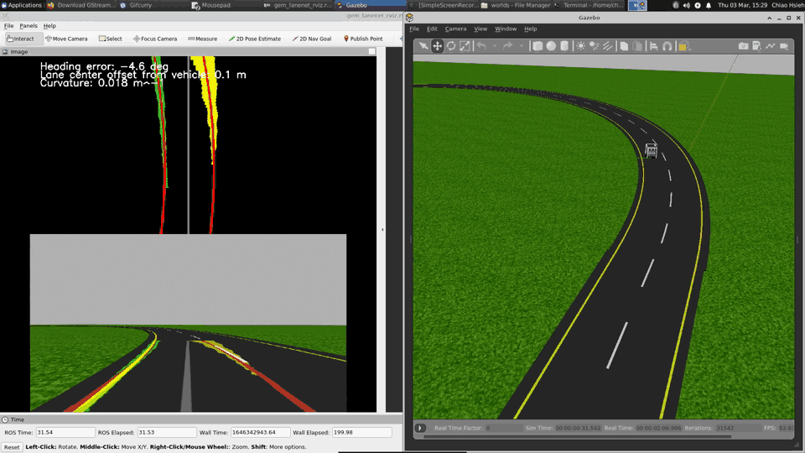
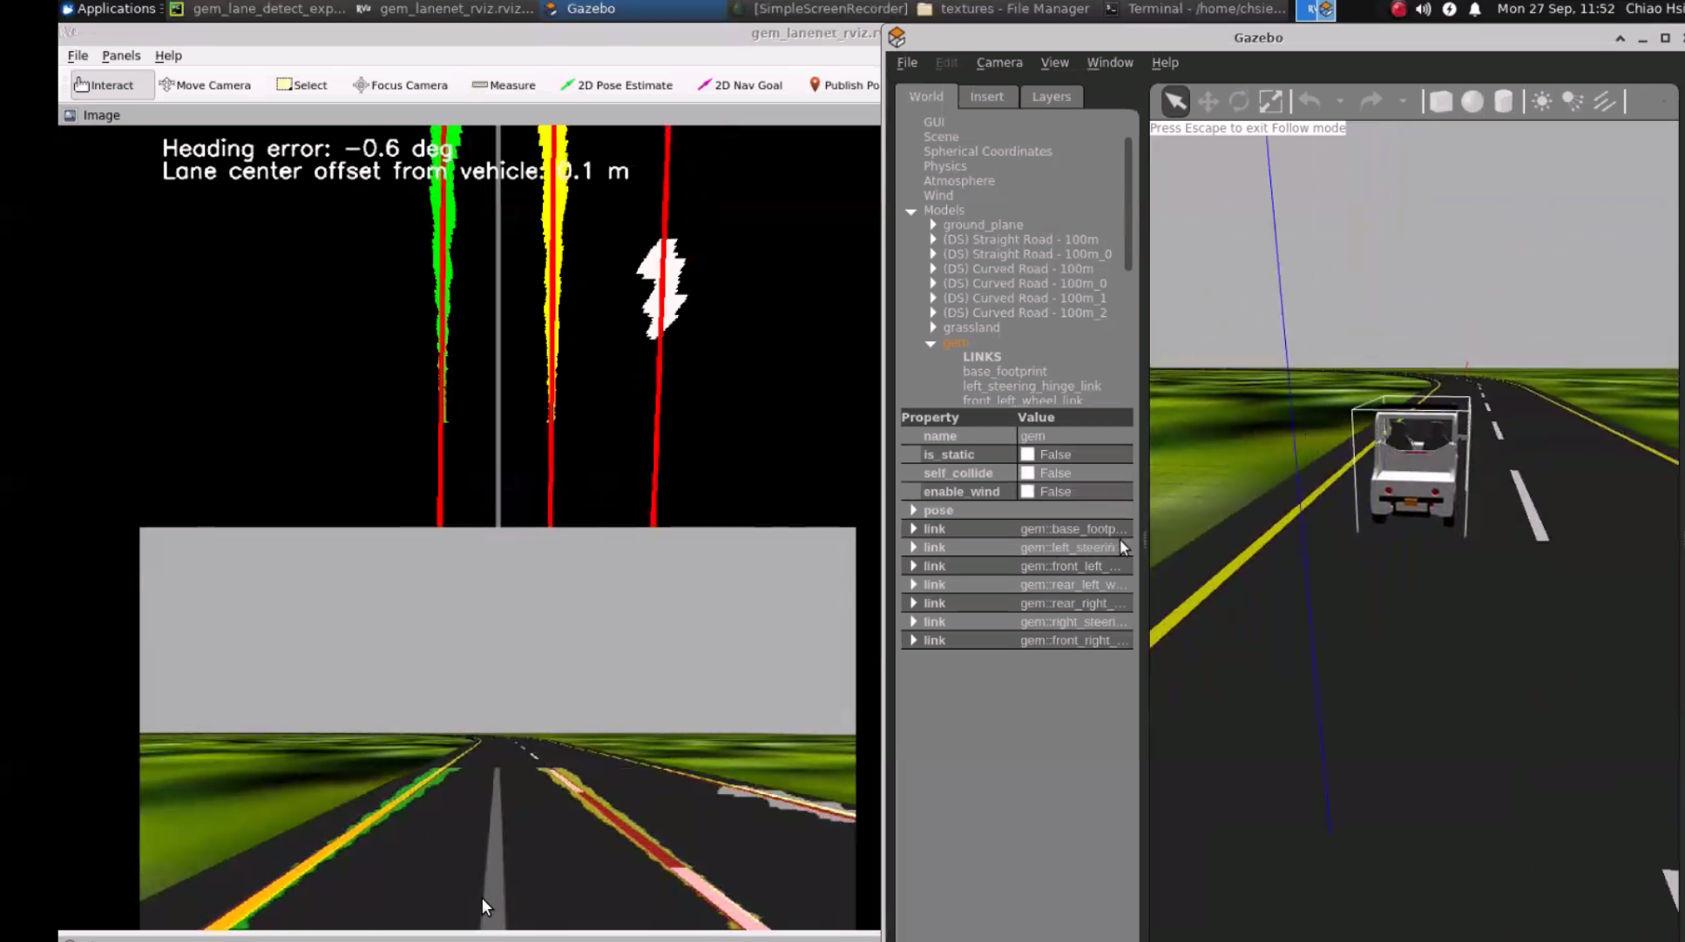
Insight 1: system specification is well-defined against ground truth states
def control(heading, dist):
# Calculate controller output
delta = heading + arctan(K*dist, VEL)
if ...
elif ...
...
return steering
Perception. relative position
DNN
Controller
Control action.
steering angle, etc.
Image
State. position
Camera
Car
Invariance on state: Track lane center
Environment.
lighting, weather, etc.

Slide 10
Insight 2: low dimensional contract with state + perception combined
def control(heading, dist):
# Calculate controller output
delta = heading + arctan(K*dist, VEL)
if ...
elif ...
...
return steering
Perception. relative position
Perception is a state estimation task which are naturally formalized w.r.t ground truth state.
Bypass the challenges on formalization and high dimensional images
Approximation for Perception
(Camera & DNN)
Controller
NN Perception h
Control action.
steering angle, etc.
State. position
Sensor s
Car
Invariance on state: Track lane center

Slide 11
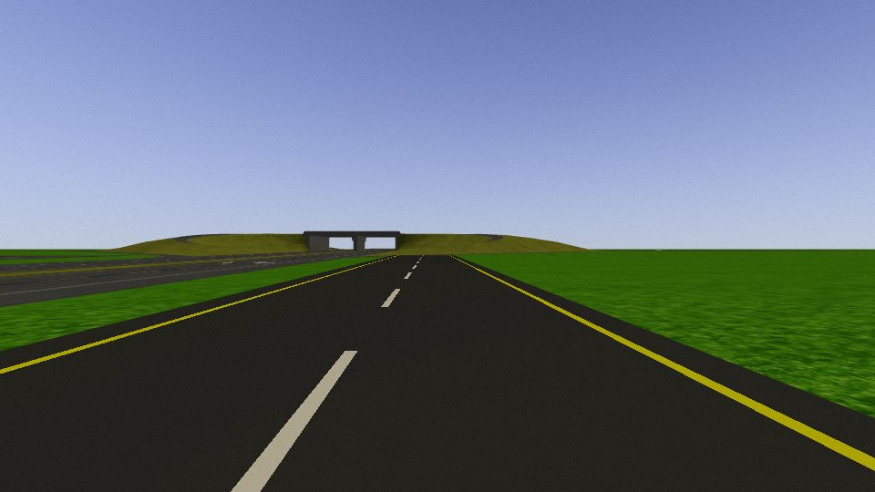
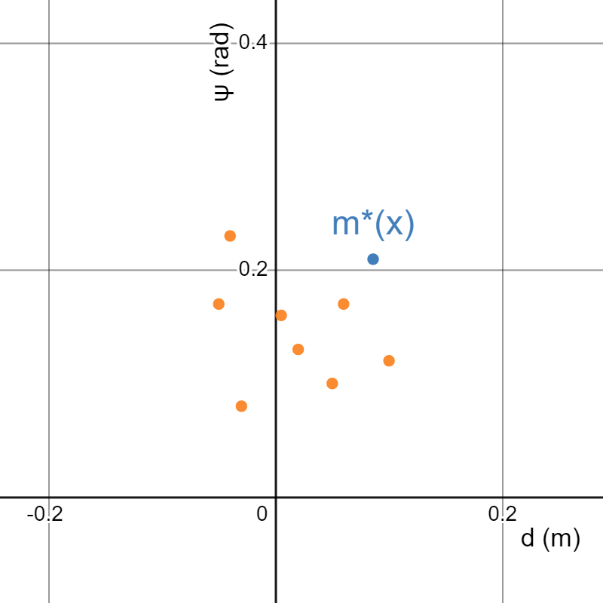
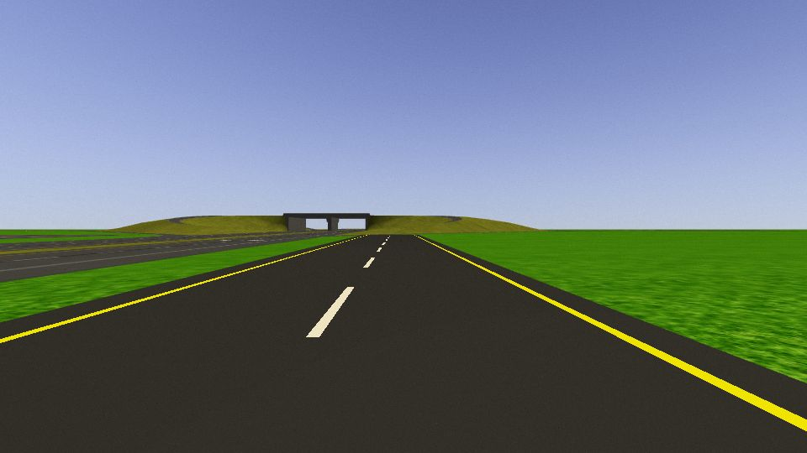
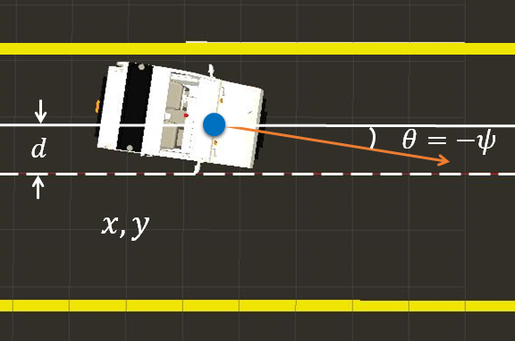
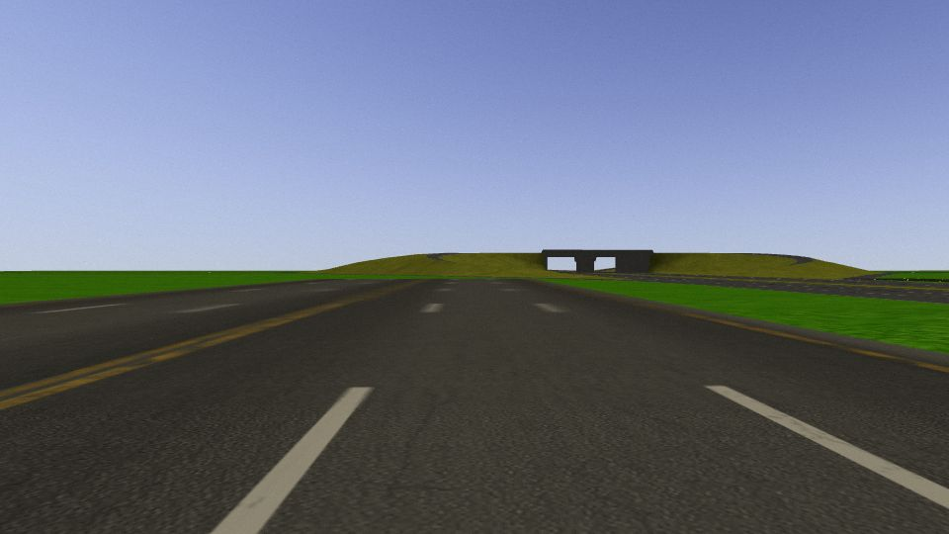
Ground truth state and perceived values
State x = (x, y, θ)
Percept z = (d, ψ) Ideal estimation m*(x)
Plot on perception domain d and ψ

Slide 12
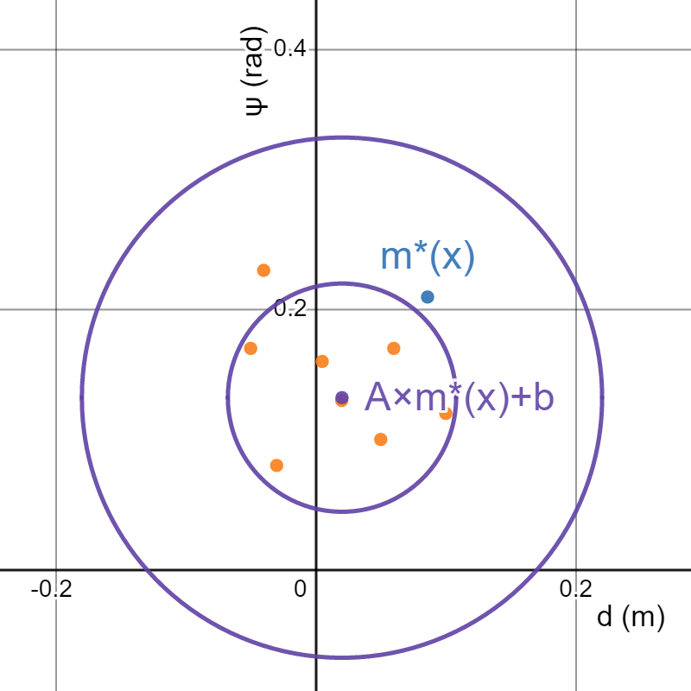
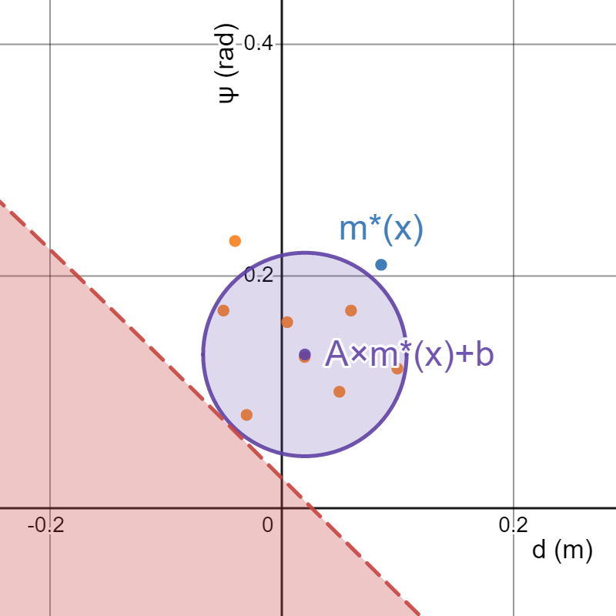
EMSOFT 2022: Safe set-valued approximation around an estimate mean center
Estimate mean (purple) from linear regression on sampled perception output, given round truth
Note estimate is not centered around m*(x) (biased)
A reasonable circle around the mean should preserve system invariance
Drawback: Unsafe percepts region leading to violation of invariance needs to encode controller and vehicle dynamics and solve constrained optimization.
Unsafe percepts in red region will lead to wrong control actions and in turn violate invariance.

Slide 13
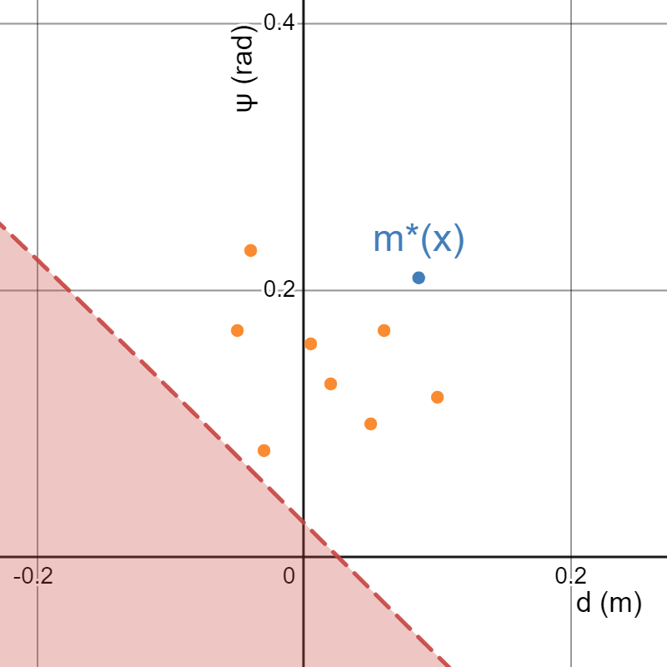
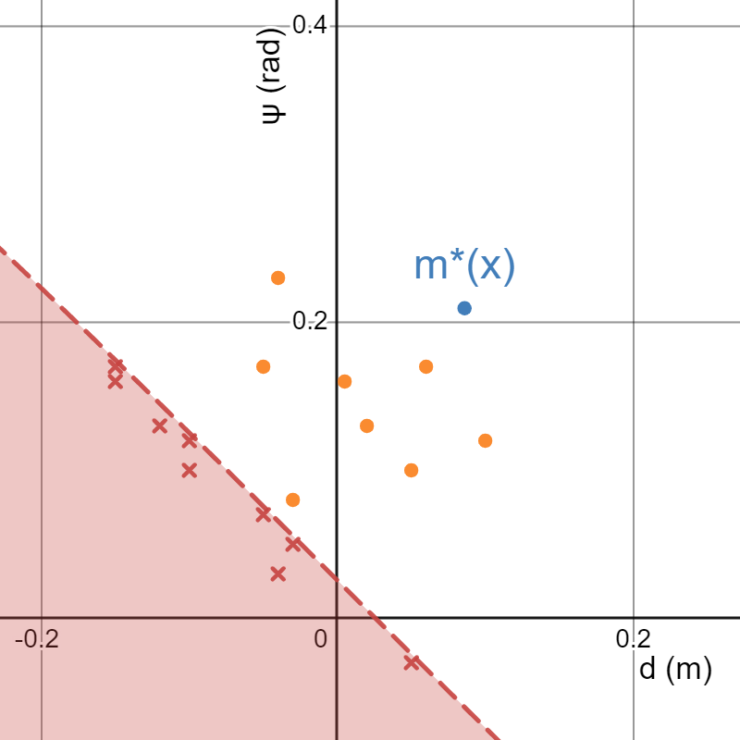
PLDI 2023 submission: Insight is to separate safe and unsafe perception outputs
More generally, synthesize a Boolean formula (binary classifier) to separate safe perception output (positive examples) from unsafe percepts (negative examples).
Constrained optimization is conceptually to find the nearest unsafe percepts for bounding circle shaped formulas.
Unsafe percepts in red region will lead to wrong control actions and in turn violate invariance.

Slide 14
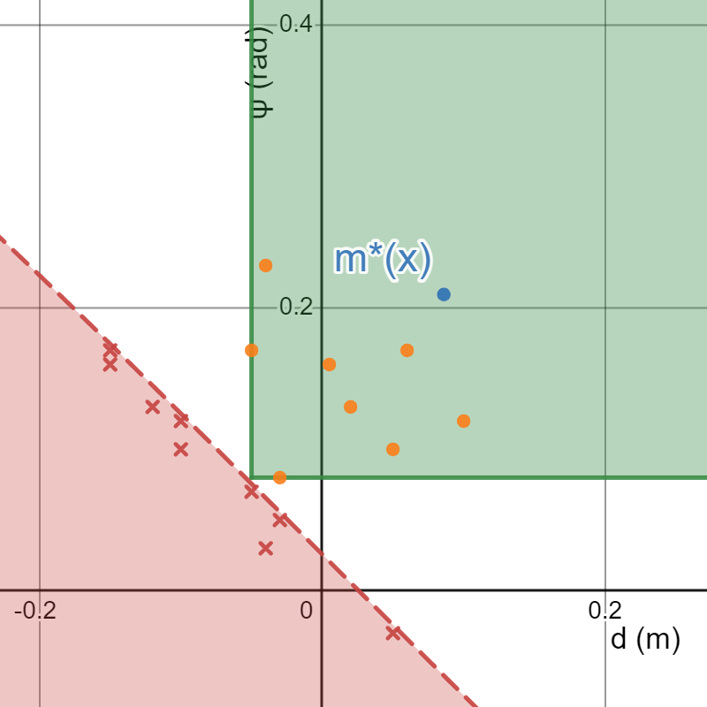
The problem of learning approximations of perception
Design the hypothesis space by choosing “simple” logic formulas.
E.g., syntax for decision tree on axis-aligned half-planes
b ::= d ≥ c | ψ ≥ c
φ ::= ite(b, φ, φ) | true | false
Exact learning: Learned formula φ must exclude all negative examples to preserve system invariance.
Maximality: Cover as many positive examples allowed in hypothesis space

Slide 15
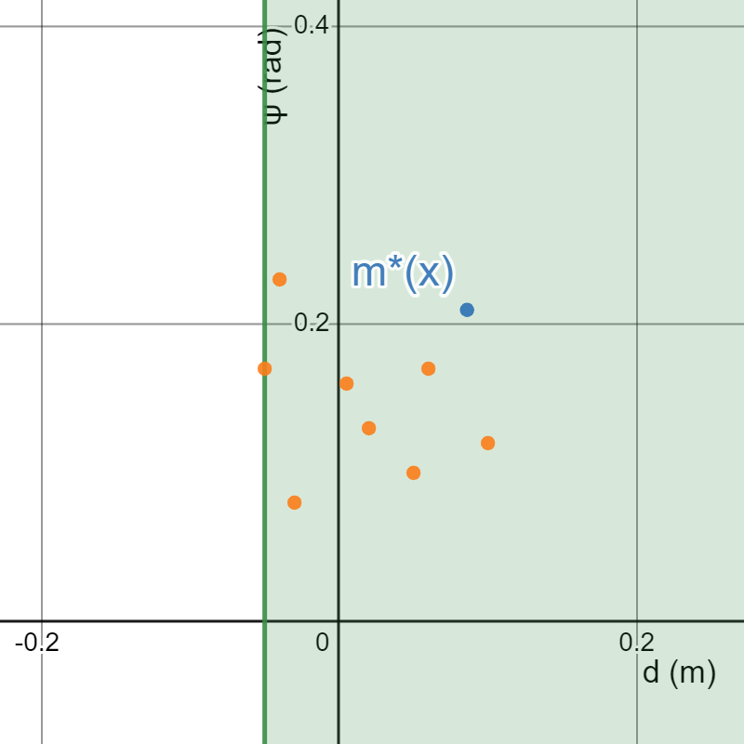
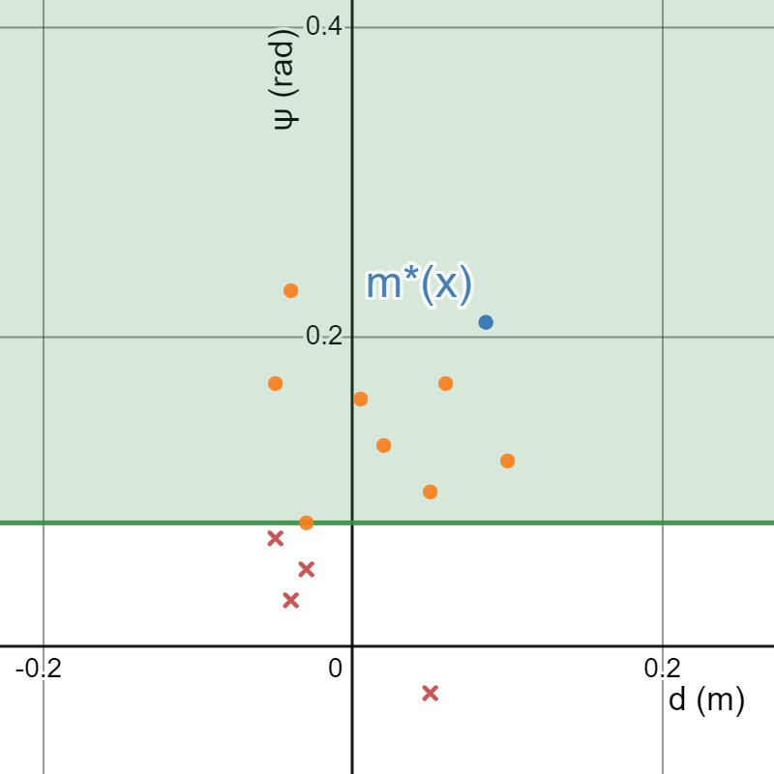
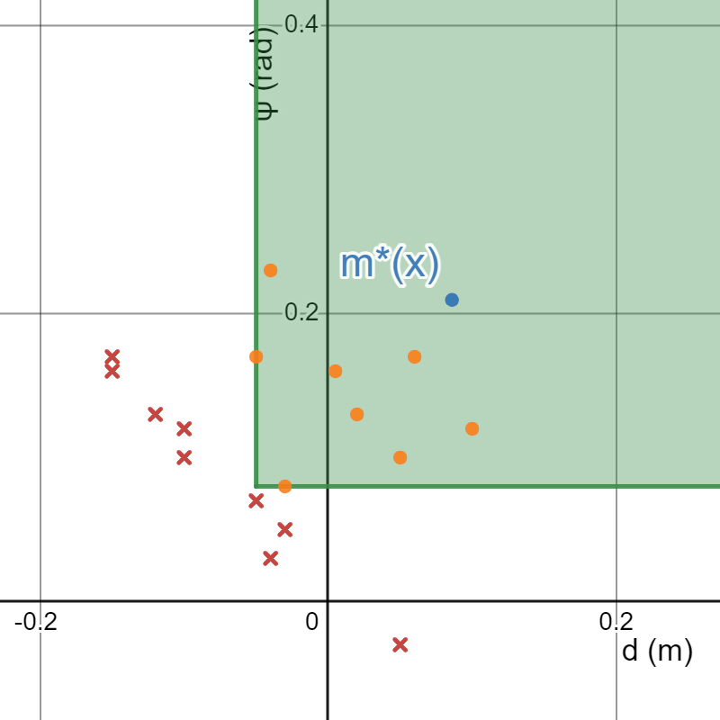
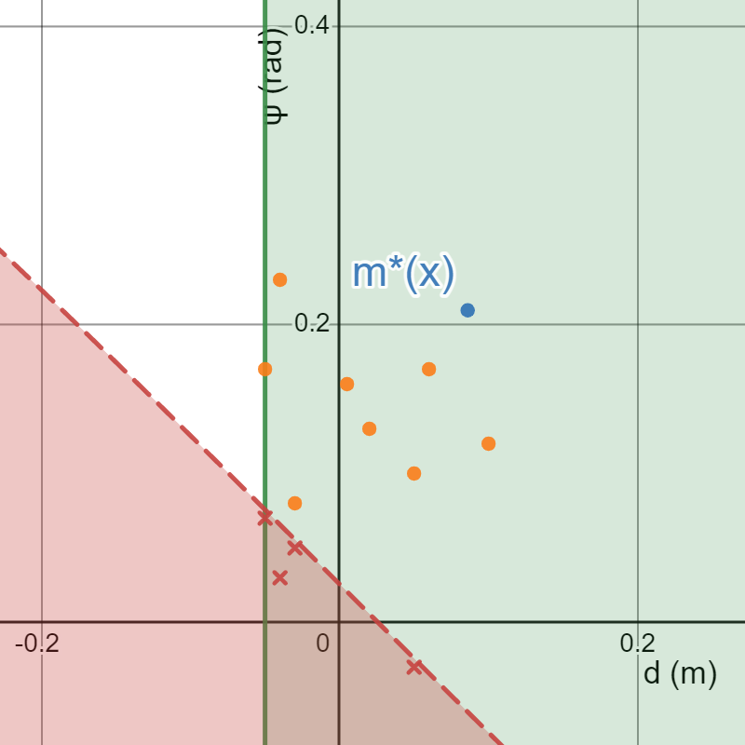
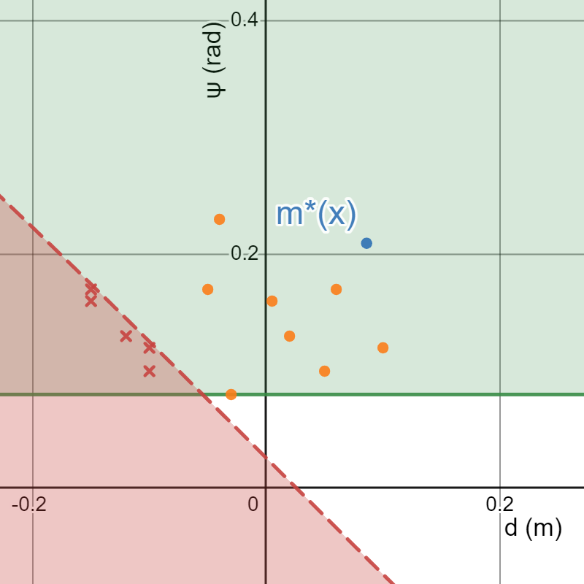
Illustration of the iterative algorithm
Iteration 1
Iteration 2
Iteration 3
Learner
d ≥ -0.05
ψ ≥ 0.08
ite(d ≥ -0.05, ψ ≥ 0.08, false)
Teacher
Done

Slide 16
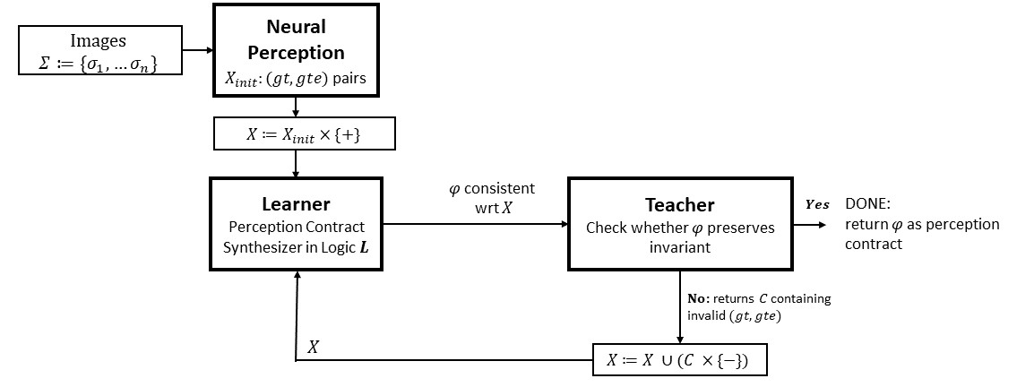
Iterative teacher learner framework
We instantiate this framework with an exact decision tree learner and use Gurobi as the teacher.
We defined the logic syntax to learn over octagonal constraints.

Slide 17
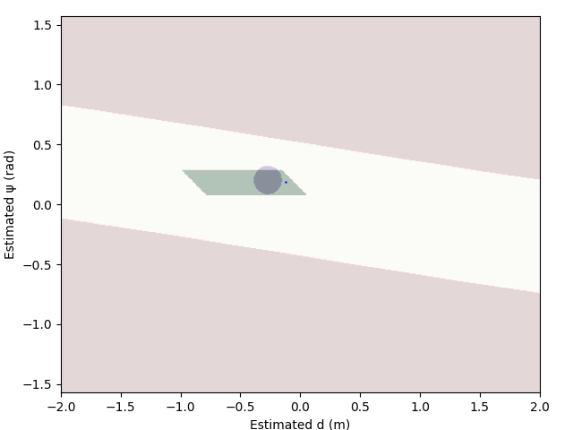
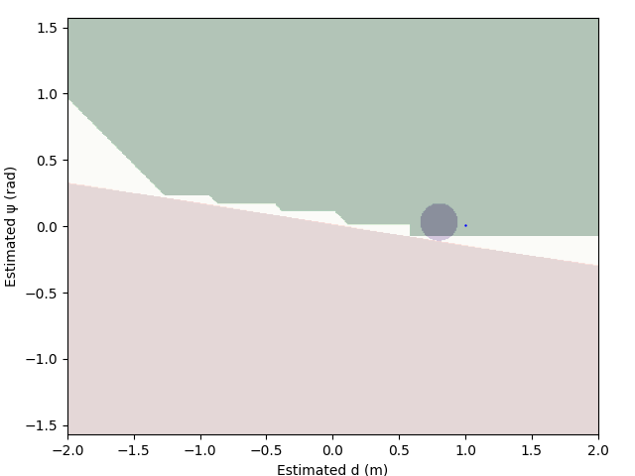
Comparison on EMSOFT and PLDI
Learned region can be nonconvex as allowed in the syntax of logic formulas.
Learned region can be unbounded due to saturated control output

Slide 18
Next steps
A general learning framework to find PCs
Choose simple logic formula syntax
Iterative learner-teacher architecture
Maximal to include as many observed percept values as possible
New formalization to support controllers with states
E.g., past perceived values for filtering or prediction
Next: Runtime assurance and control synthesis using PCs

Slide 19
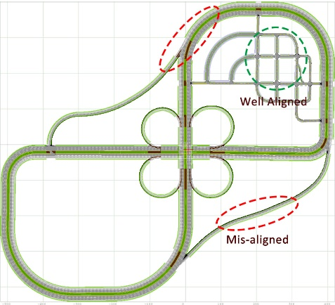
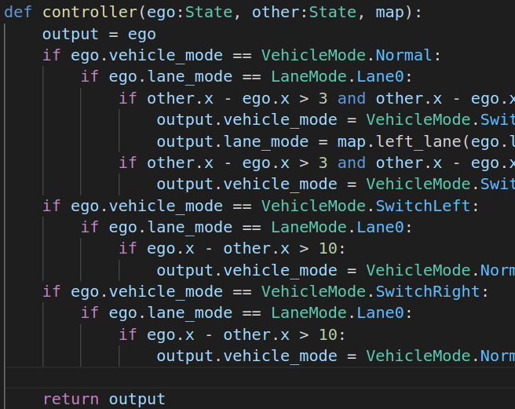
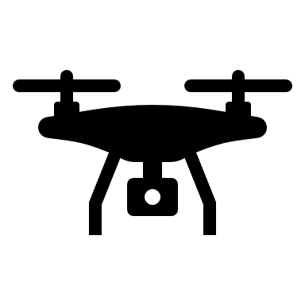
New Verse library for verification
Learning sensitivity from data
Reachability, composition,
fixpoints
Exploiting symmetries in dynamics
[CAV 21, TACAS 19]
Learning reachability functions [TACAS 22]
map / scenario
Transition logic
Executable access to mode dynamics
+
controller code
JSON file
transition structure extracted
Black-box physics simulator
Multi-agent interactions
19

Slide 20

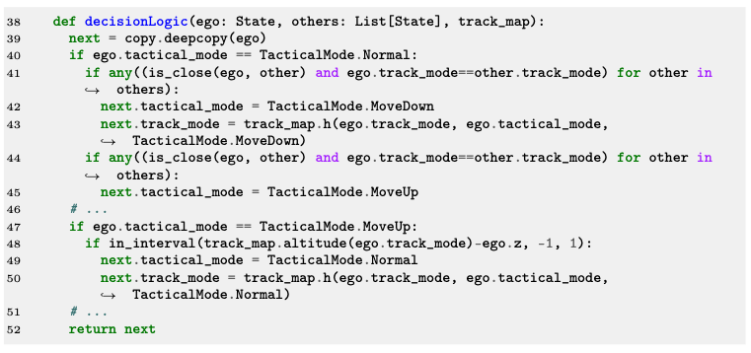
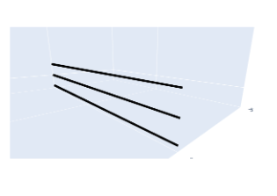
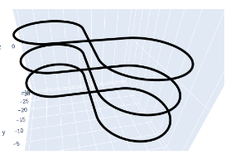
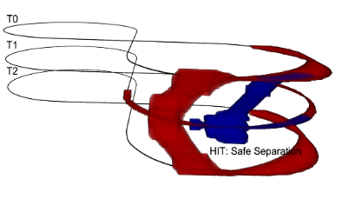
We are building the Verse library for code-level verification of autonomy
Python Code for describing agent’s decision logic
Instantiate multiple agents, maps to construct complex air-traffic scenarios
Plug-in reachability analysis DryVR [4], Flow*
Safety requirements written as Python assertions
Applied to drone control system [Lin Song’22]
[4] DryVR: Data-driven verification and compositional reasoning for automotive systems, Fan, Qi, Mitra & Viswanathan, CAV 2017, Heidelberg, Germany, July 24-28, 2017.
Verification and Certification
Sayan Mitra

Slide 21
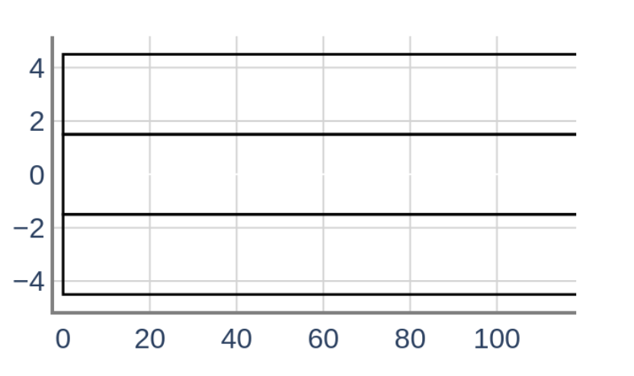
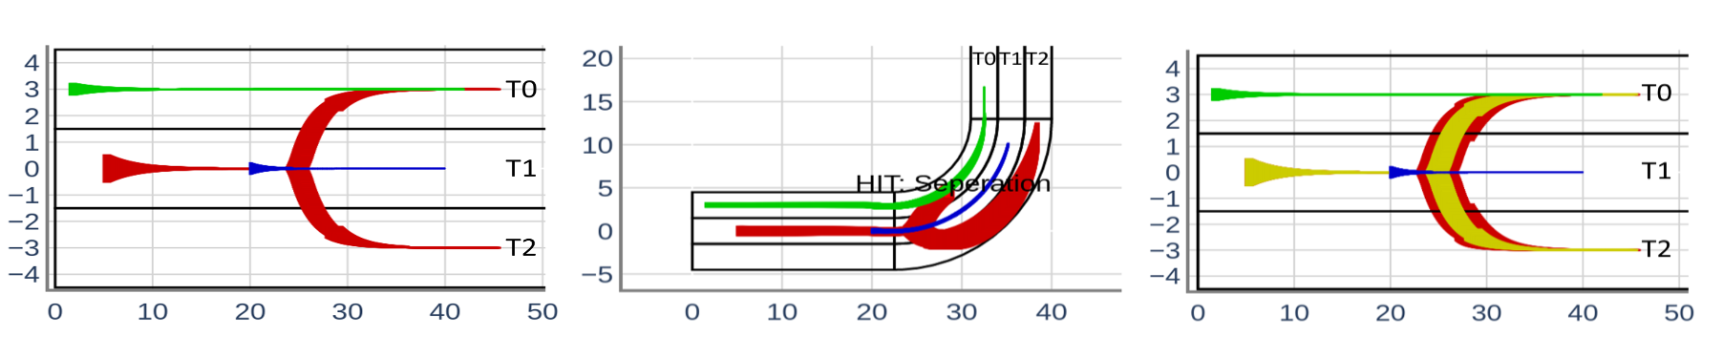
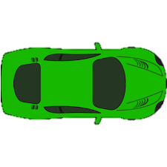
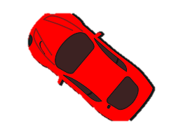
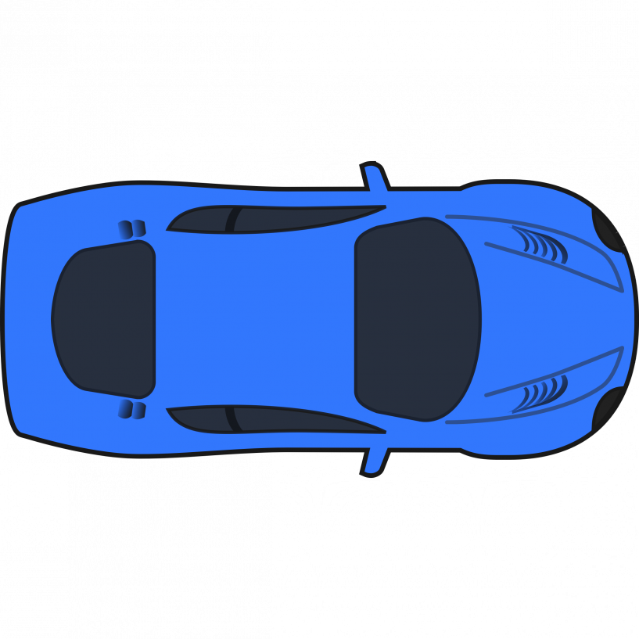
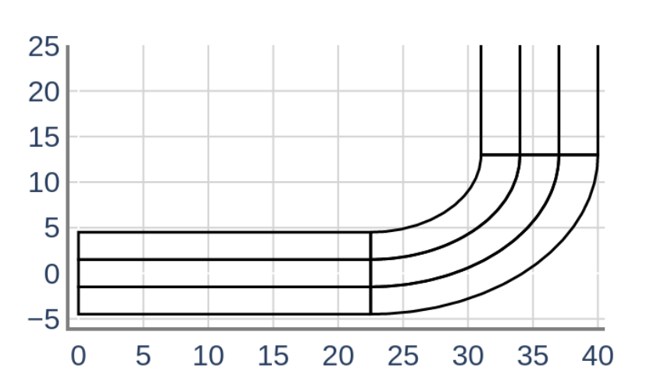
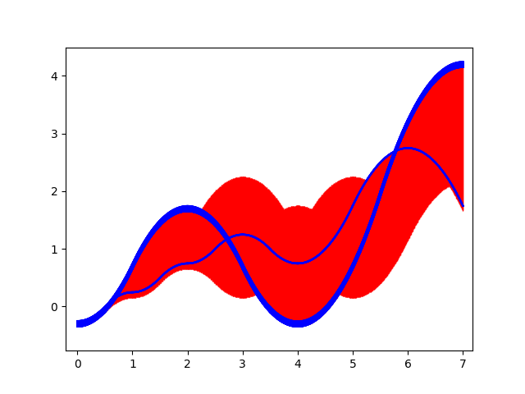
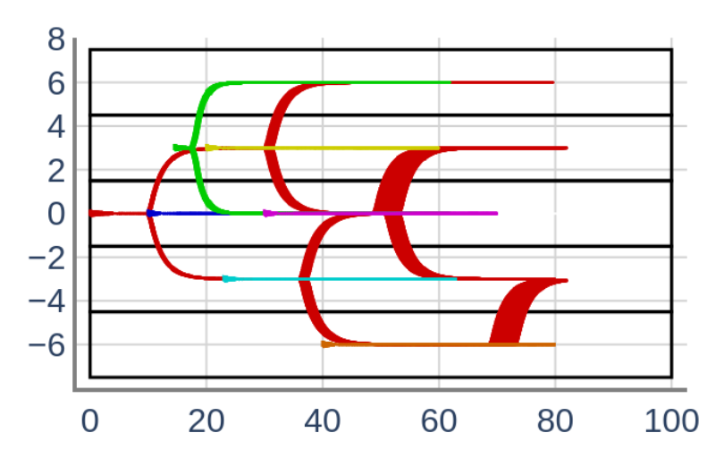

Reachability analysis explores all uncertainties
Port agents to new maps and scenarios with few lines of code
Analyze scenario with different sensors
Safety requirements written as Python assertions
Create and analyze scenarios with many agents
Ready for incremental verification and symmetry reduction
Plug-in different reachability analysis DryVR [4], Flow*
Next Steps
Several ongoing collaborations
Parallelization of reachability algorithms with Ray
Sayan Mitra

